Slide 1

EventBlitz
An Event Management Solution

Slide 2
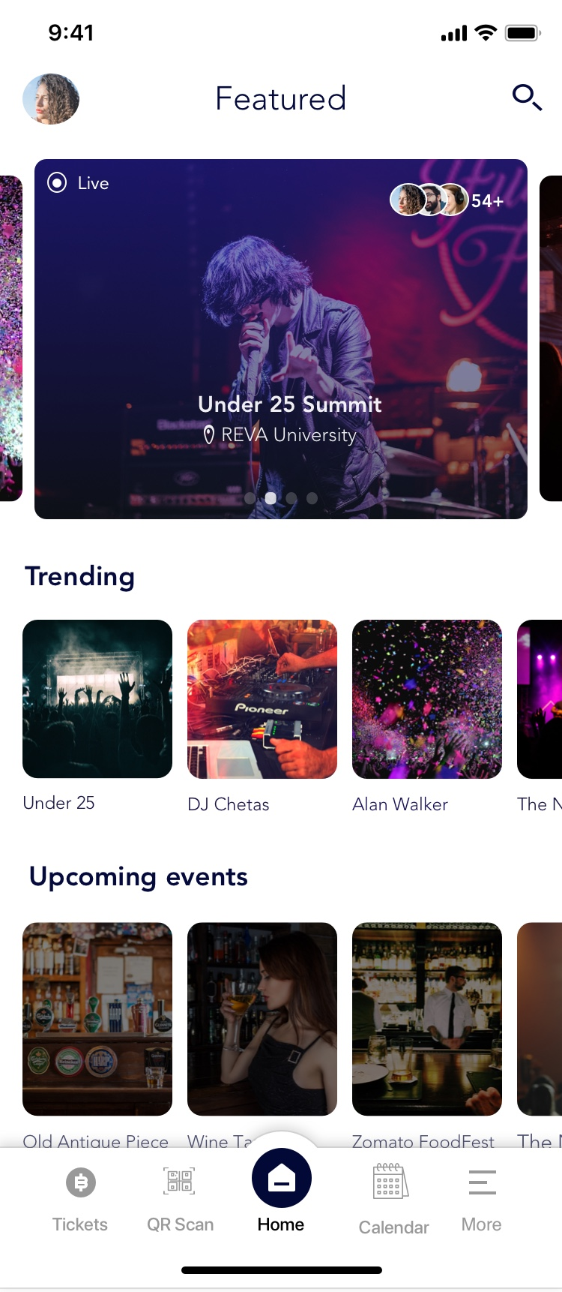
Features
Event Registrations
Venue Voting
Ticket Management
QR Code scanner for On-Spot Registrations
Push Notifications for Upcoming Events
Admin Panel to Track Registrations

Slide 3
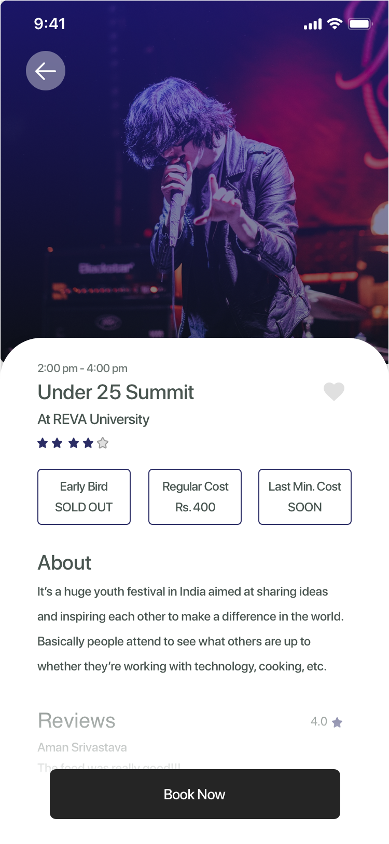
Event Registrations
Event Hosts can post event details through the admin panel.
Hosts can track ticket registrations statistics.
Participants can register through the event page by a single click.
A Unified Interface for event registrations.
Participants can write reviews regarding their experience.

Slide 4
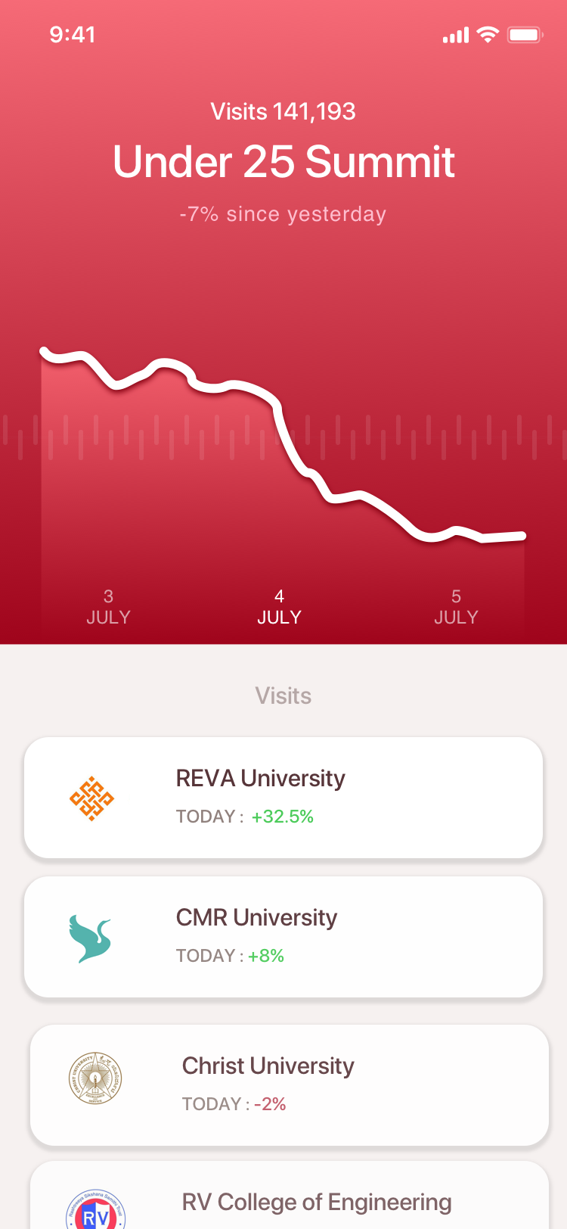
Admin Panel
Add events
Contains metrics for ticket registrations.
Event Hosts can track number of visits from different colleges.

Slide 5
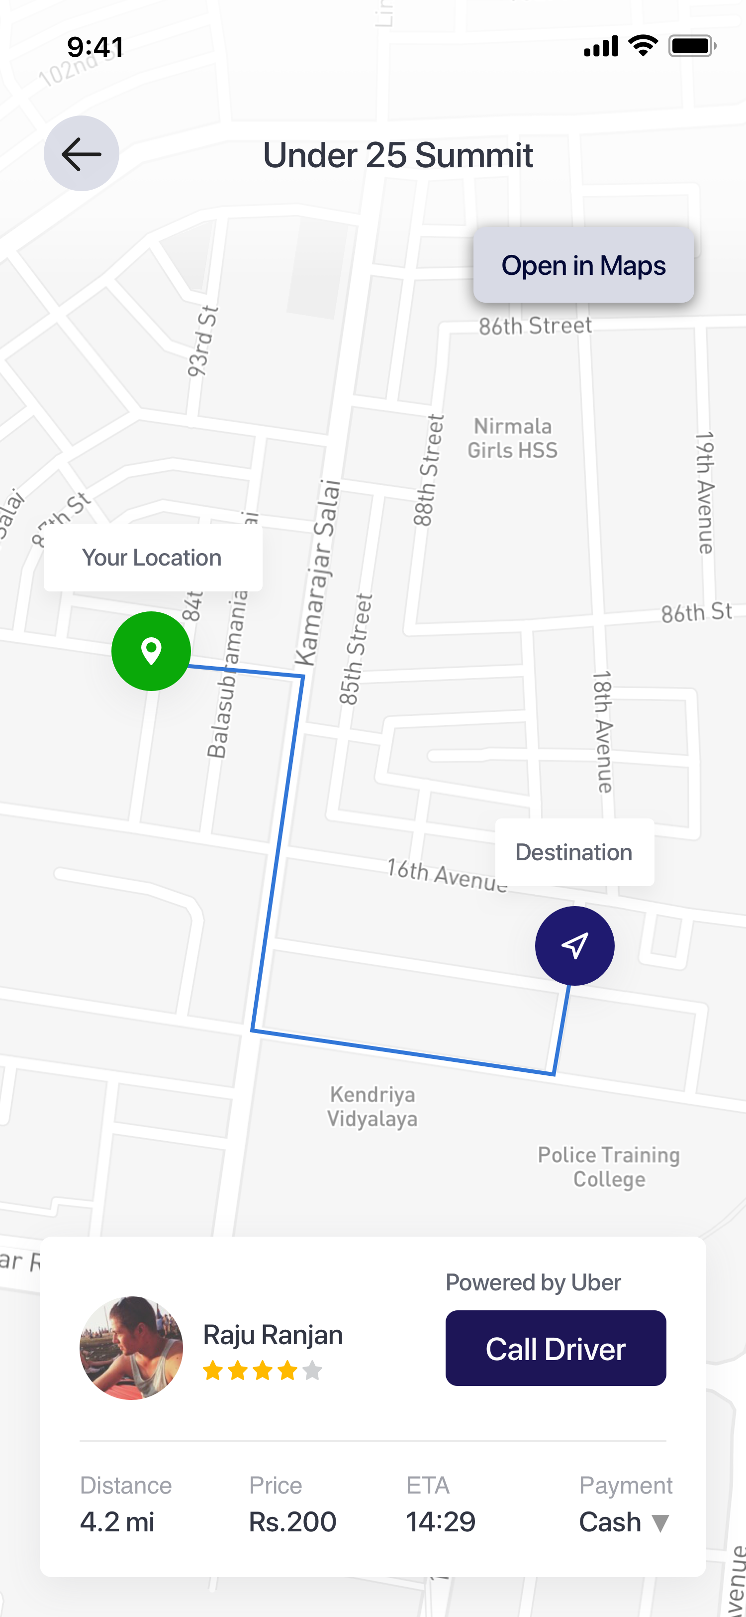
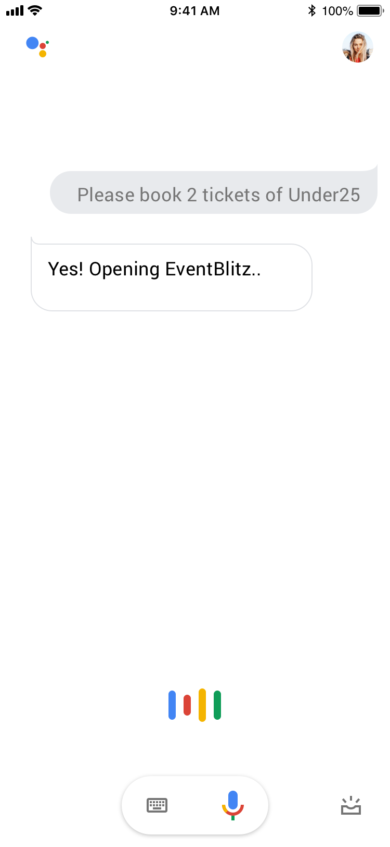
Other Features
Navigate to Event
Book a cab right from the EventBlitz app
Uber/Ola Integration to book cabs
Google Assistant Integration
You can use voice commands to:-
Book Tickets
View Registrations
Navigate to Event

Slide 6
Business Model
The app can be monetized using different ways: -
Featured Events
Ticket Handling Charges
Uber/Ola Referral Commission
EventBlitz Premium Membership for Ticket Discounts

Slide 7
Prototype

Slide 8
Thank You!
Made By -
Anurag Sharan
Aniketh Hotagi
Adarsh Nair
Ankit K. Jaiswal
Aman Shrivastava

